Slide 1
Redmine Extension Investigation
[NEC Group Internal Use Only]
August 31, 2017

Slide 2
Contents
Redmine Extension Investigation Request
1. Build full-text search function with DMSF plug-in function

Slide 3
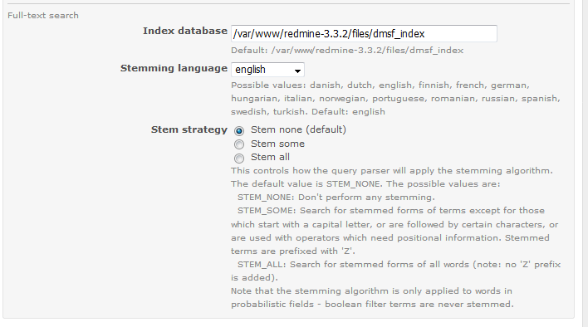
Build full-text search function with DMSF plug-in function 1/7
Problem:
DMSFプラグイン(https://github.com/danmunn/redmine_dmsf)にはドキュメント検索システムとの連携機能があるようですがメニューでは対象言語に日本語が指定できないようで、本機能を使用した全文検索機能を有効化する方法について教えて頂けないでしょうか。
(★そもそも.docx/.xlsxなどの文章をサーチする機能と思っているのですがあっていますか？)
I would like to build full-text search function with DMSF plug-in function Although the DMSF plugin (https://github.com/danmunn/redmine_dmsf) seems to have a linkage function with the document search system, Japanese seems to be unable to specify the target language in the menu, and full-text search using this function Can you tell me how to activate the function? (★ Do you think that it is a function to search sentences such as .docx / .xlsx in the first place?

Slide 4
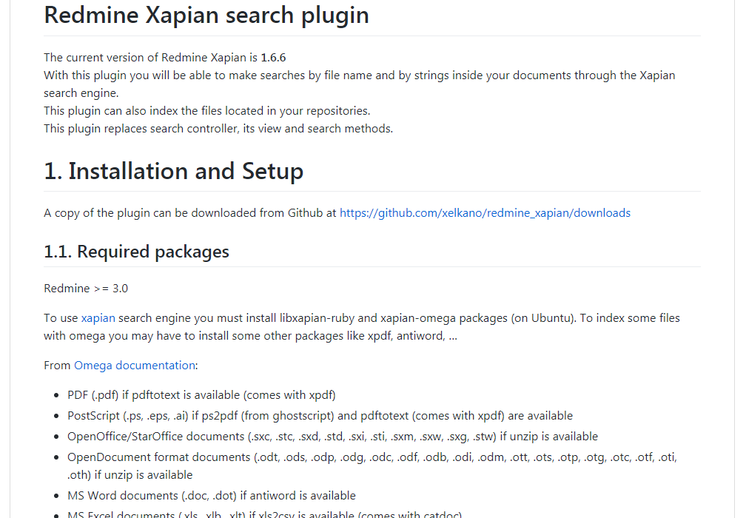
Build full-text search function with DMSF plug-in function 2/7
Findings:
Another plugin, redmine_xapian can be used on top of DMSF to support Japanese character search
A tokenizer for CJK (Chinese, Japanese, Korean) characters has been patched to Xapian and functional at version 1.2.8
Setting an environment variable XAPIAN_CJK_NGRAM enables the said tokenizer for CJK strings

Slide 5
Build full-text search function with DMSF plug-in function 3/7
Solution:
Step 1. Install Redmine DMSF dependencies
# yum install epel-release
# sudo yum install xapian-omega libxapian-dev xpdf poppler-utils antiword \
unzip catdoc libwpd-tools libwps-tools gzip unrtf catdvi djview djview3 \
uuid uuid-dev libuuid-devel xz-utils
Download the following (version 1.2.8):
* xapian-core
* xapian-omega
* xapian-bindings
# tar xf xapian-core-1.2.8.tar.xz
# tar xf xapian-omega-1.2.8.tar.xz
# tar xf xapian-bindings-1.2.8.tar.xz
# cd xapian-core-1.2.8
# ./configure
# make
# make install
# cd xapian-omega-1.2.8
# ./configure
# make
# make install
# cd xapian-bindings-1.2.8
# ./configure
# make
# make install

Slide 6


Build full-text search function with DMSF plug-in function 4/7
Solution:
Step 2. Install Redmine DMSF plugin
1. Stop the web server
2. Clone redmine_dmsf plugin to plugins directory
# cd {redmine root directory}
# git clone https://github.com/danmunn/redmine_dmsf plugins/redmine_dmsf
# bundle install
# bundle exec rake redmine:plugins:migrate RAILS_ENV="production“
Step 3. Install Redmine Xapian plugin
1. Clone redmine_xapian plugin to plugins directory
# cd {redmine root directory}
# git clone https://github.com/xelkano/redmine_xapian plugins/redmine_xapian
2. Run bundler
# bundle install
# bundle exec rake redmine:plugins:migrate RAILS_ENV="production“
Step 4. Code Modification
Change the minimum token size from 2 to 1
redmine/lib/redmine/search.rb

Slide 7
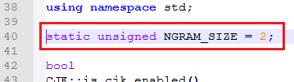
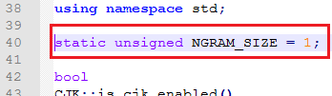
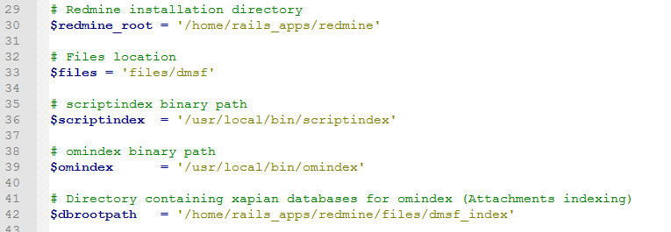
Build full-text search function with DMSF plug-in function 5/7
Step 4 (Cont.) Code Modification
- Change NGRAM_SIZE value from 2 to 1 in xapian-core-1.2.8\queryparser\cjk-tokenizer.cc
Setup Redmine Xapian
“It’s very important to set up correctly the directory that will contain the Xapian databases.”
Modify redmine/plugins/redmine_xapian/extra/xapian_indexer.rb
Set $redmine_root to your redmine root directory
Set $files to your dmsf files directory. For example,
$files = 'files/dmsf'
Set $scriptindex to the path to scriptindex.h file
Set $omindex to the path to omindex.h file
Set $dbrootpath to your database files' directory. For example,
$dbrootpath = '/home/rails_apps/redmine/files/dmsf_index'

Slide 8
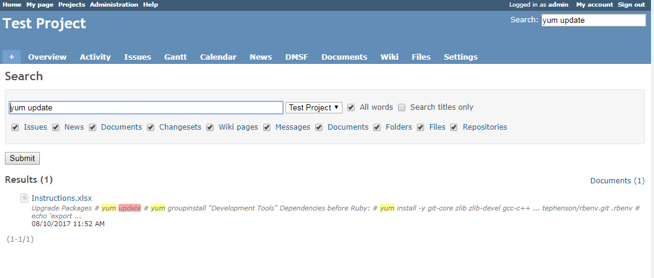
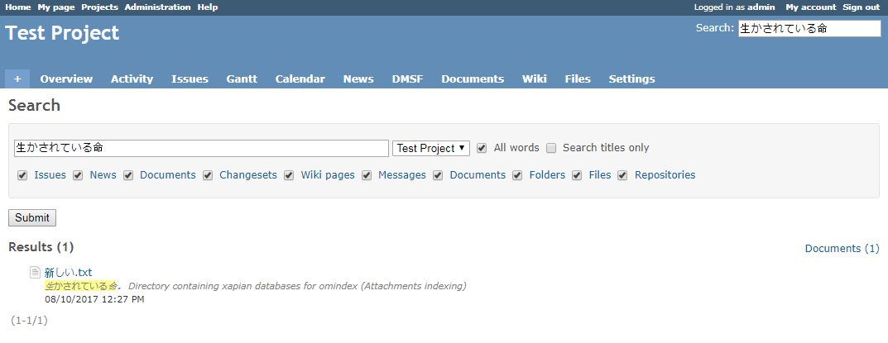
Build full-text search function with DMSF plug-in function /7
Result:
Full-text search on English content
Japanese character search

Slide 9
Build full-text search function with DMSF plug-in function 7/7
Notes
Capability:
Can support Japanese character query strings of any length
Versions:
Redmine 3.3.2
Redmine DMSF 1.5.9
Redmine Xapian 1.6.6
Xapian Core 1.2.8
Xapian Omega 1.2.8
Xapian Bindings 1.2.8

